Slide 1
The Basics

Slide 2
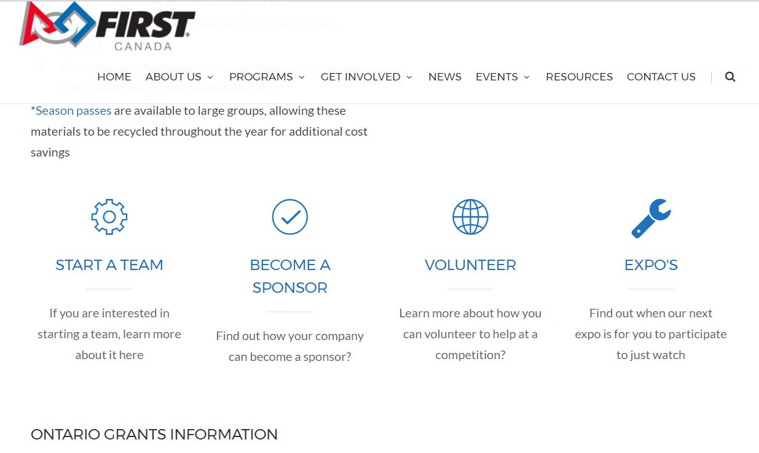
Links
www.firstroboticscanada.org/flljr/flljrontario www.firstinspires.org/robotics/flljr

Slide 3
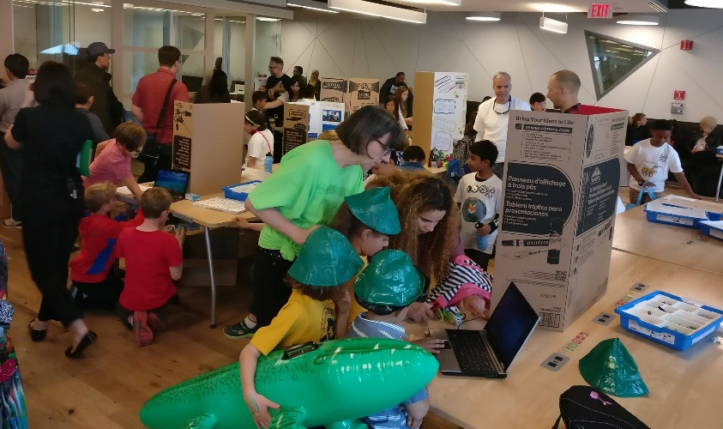
What is FIRST LEGO League Jr.????
Children Ages 6-10 (Grades K-4)
Teams of 2-6 children
Coaches are mostly parents and teachers
Registration: August - April
$99 USD Registration Fee (Season’s Passes available for large groups)
Fee includes Coach materials & Access to Online
LEGO model and Show Me poster
Events called Expo’s
Events are 2-4 hours long…That’s it!
Unofficial events organized by community members in US/CAN
Official Expos held by FIRST LEGO League Jr. Affiliate Partners and designates as well as Season’s Pass holders.
Notes:
Play What is Jr.FLL Video
Coaches materials include:
Challenge doc that explains yearly themed challenge
Coach Guide for running a Jr.FLL team
Coach Resources with tips and resources to use on that year’s specific theme
Model & Poster
We want the model to have a simple machine and a motorized part
Posters include info on each team member, research done and model made – New challenge docs will include more specific information on Poster layout – this helps both reviewers and spectators know what they’re looking at as layouts will be similar poster to poster.
Events – will go over this more in-depth in a future slide
Keep them short and simple – remember these are little kids
Anyone can organize an Expo – the more the merrier mentality – do not feel you have to have an expo for every team in your area.

Slide 4
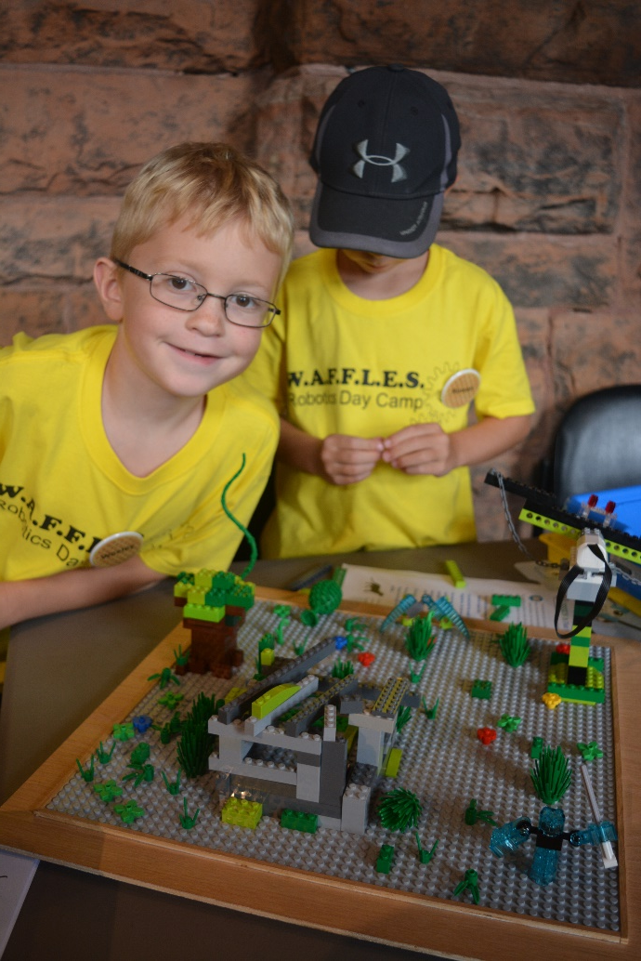
What is FIRST LEGO League Jr. continued..
Differences from other FIRST programs
Noncompetitive
EVERYONE receives an Award
No Game!
No Robot!
Terminology
FIRST® LEGO® League Jr. (no short forms or variations please)
Expo – an official event with 5 or more teams
Notes:
Noncompetitive is key.
No specific awards however we do give a list of suggested awards in the Event Guide – make sure the names are noncompetitive.
EVERYONE MUST win an award to keep the event noncompetitive. – So if you’re giving out medals, certificates etc – everyone gets one – Trophies can be given out 1 per team.
No Game – but there is a theme every year – same as FLL.
No Robot though robotics is introduced.
No Mandatory Products – but we do put together a base kit and robotics kit every year with LEGO Ed at a discounted price. Teams can purchase/use WeDo or ANY other LEGO products and use them in their model
Terminology
- Make sure to use the ® on FIRST, LEGO or Jr.FLL the first time it’s used in a document

Slide 5
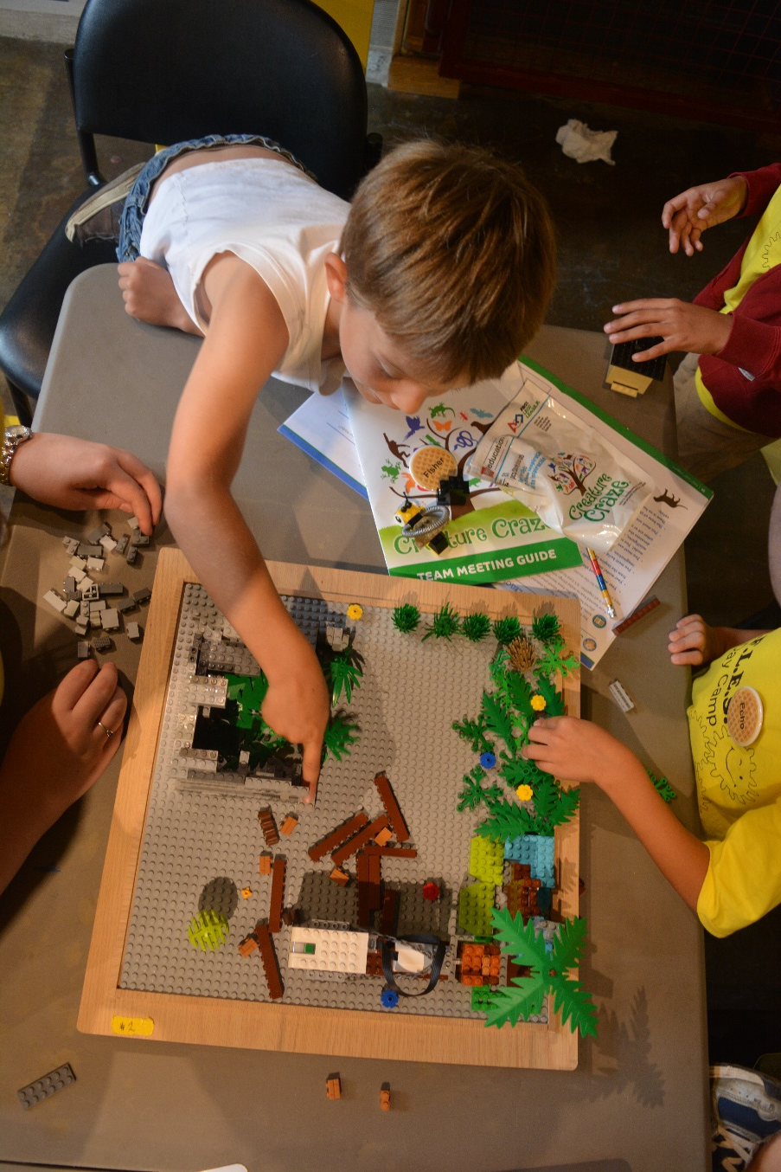
Who?
Team Profile:
Home School Communities, After school Programs, Elementary School PTA’s, Libraries, Science Centers, Children’s Museums, etc.
Coach Profile:
Parents, teachers, engineers, scientists, college students and scout leaders
Coach Responsibilities:
Mentoring
Liaison
Expectations
Core Values
Notes:
Team Profiles: Teams are made from all kinds of different groups, these are just a few of the most common
Coach Profile: Good coaches come from many walks of life and have included teachers, parents, engineers, scientists, college students, and scout leaders.
Most coaches said that they heard about the Jr.FLL Program from another parent or from a school.
Coach Responsibilities:
mentoring the team through the season’s Jr. FLL Challenge, as well as for planning and scheduling meetings, visits, and trips.
liaison between team members, mentors, parents, and volunteers.
It is important the coach inform kids and parents about what is expected of them in terms of their commitment to the team.
Coach is also responsible for honoring and communicating Jr. FLL core values to team members, team volunteers, and others affiliated with their team.

Slide 6
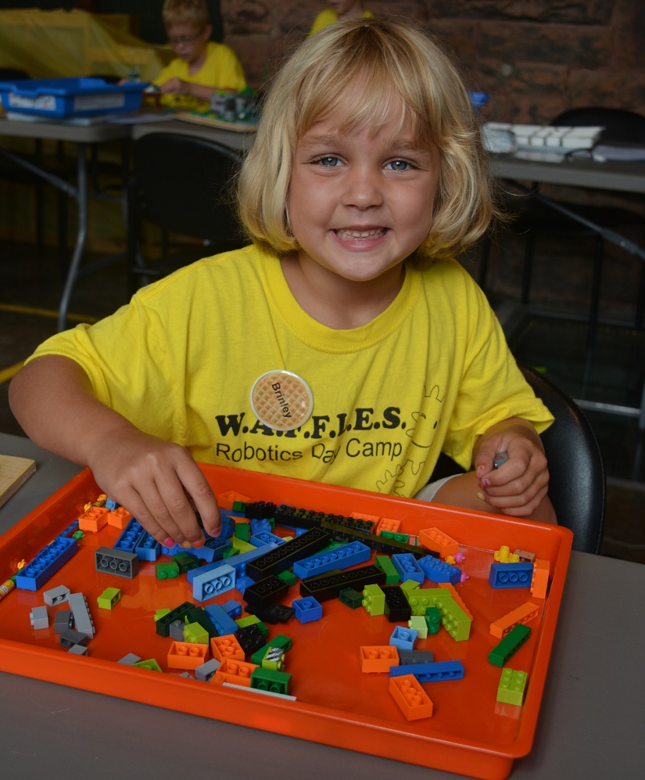
FIRST LEGO League Core Values
We are a team.
We do the work. Our coaches and mentors help us learn, but we find the answers ourselves.
We share our experiences and discoveries with others.
We are helpful, kind, and show respect when we work, play, and share. We call this gracious professionalism.
We are all winners.
We have fun.
Notes:
Just like all other FIRST programs – Jr.FLL has their own set of Core Values

Slide 7
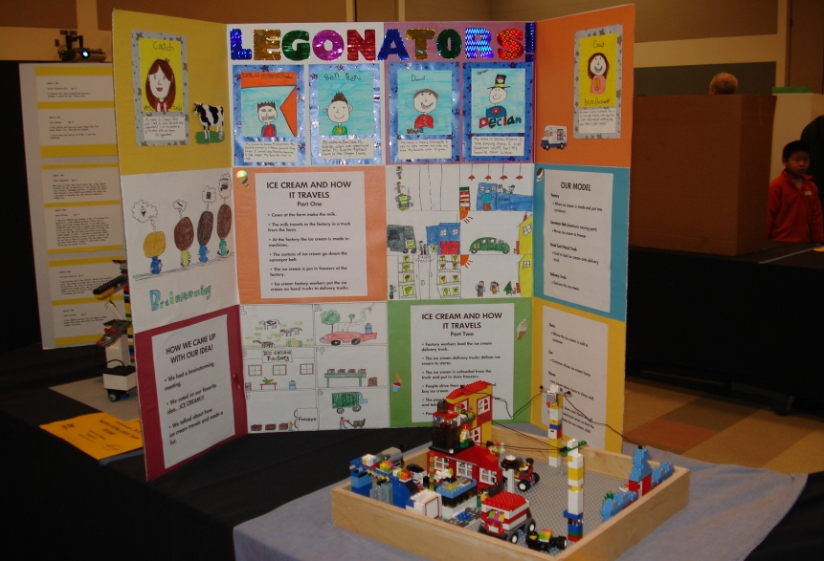
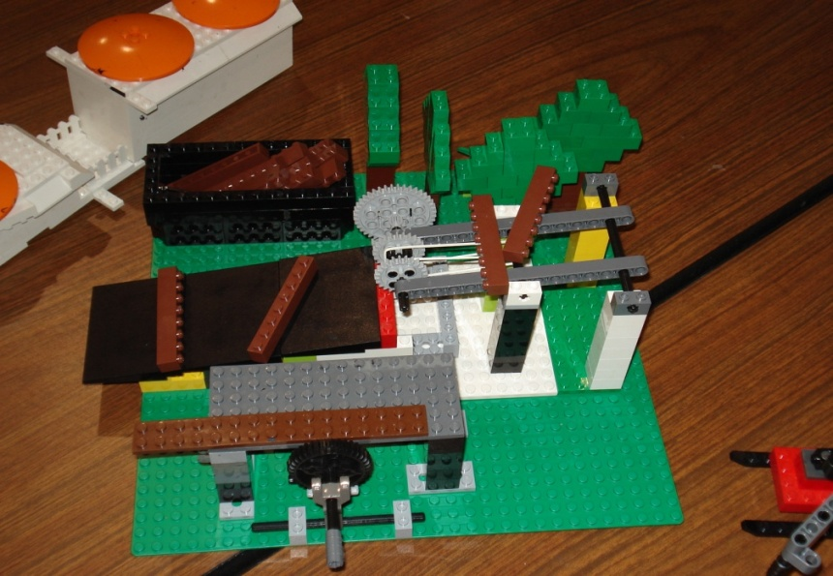
FIRST LEGO League Jr. Challenge Components
Model
Must:
Be constructed of only LEGO elements
Have a motorized moving piece using WeDo 2.0
Based on the Challenge Direction Provided in the FIRST LEGO League Jr. Challenge Document
Show Me Poster
Includes information about:
the team
topic specific research
Notes:
Guided by adult coaches, teams use LEGO elements to build a model with a motorized moveable part and develop a coordinating Show Me poster to represent their journey.
Model: Can be anything that they learned on that year’s topic. Does NOT have to be an invention. – But it can be! Needs to be 15x15 – teams typically use a 15”x15” baseplate
Show Me Poster: This year we are introducing some new standards so posters will look similar. These will be outlined in the Super Seniors Challenge Doc. This helps reviewers as they will have an idea of what they are looking at as layouts will be similar poster to poster. For example we’re going to ask all teams to put their team info on the right side, info about heir Senior Partner and their search on the left side and info about the item they researched and their model in the middle.

Slide 8
Example Model
Notes:
This is a great example of a model from the Body Forward season.
Models do not need to be elaborate – they can be fairly simple like this one
What are we looking at?
A dentist’s office – a very popular choice that season.
This one has 2 motorized pieces
Dentures that move up and down
A drill attached to the dentist’s chair that moves

Slide 9
Notes:
Goal for 2012 – 3700 teams
Number of events reflects those captured on our website – there are many more happening all out there – this is why it’s important to put your event up on our site.

Slide 10
Aqua Adventure℠ Season

Slide 11
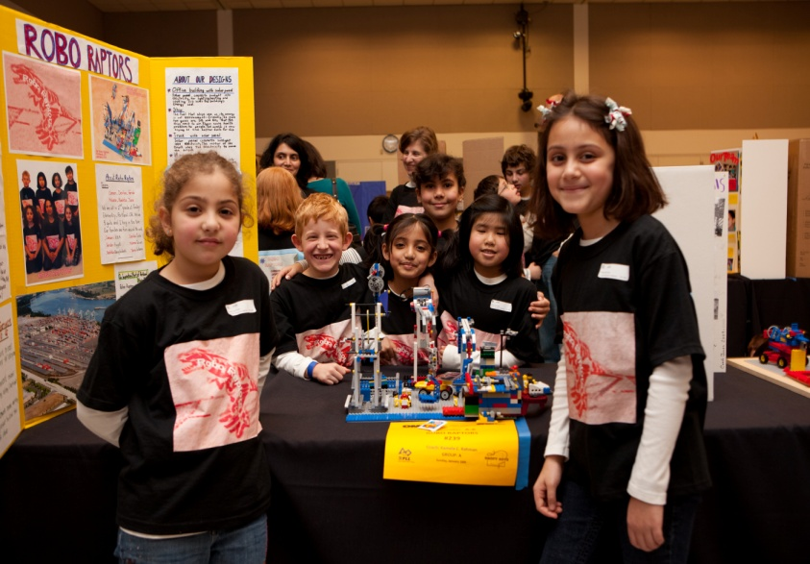
FIRST LEGO League Jr. Season
May | Registration Opens in U.S. and Canada
August | Challenge materials and LEGO Kits available for registered teams in U.S. and Canada
April | Registration Closes in U.S. and Canada
Throughout Season | Expos are held
April | World Festival Expo – Detroit, MI

Slide 12
LEGO® Education Product Offerings
Item | Canada $ Price (CAD) | Spectrum Item #
Team Registration | variable, depending on exchange rate
Season Pass - Small | variable, depending on exchange rate
Season Pass - Large | variable, depending on exchange rate
Items available for purchase after registration by clicking on the "Order Product" button on the Dashboard
Community Minifigure Set | $67.95 | 733444
Creative LEGO Brick Set | $69.95 | 730814
Gray Baseplate | $18.95 | 77957
WeDo 2.0 Core Set + Software | $203.95 | 730432
WeDo 2.0 Medium Motor | $30.95 | 730436
WeDo 2.0 Motion Sensor | $30.95 | 730437
WeDo 2.0 Tilt Sensor | $30.95 | 730438
WeDo 2.0 Smart Hub | $81.95 | 730434
WeDo 2.0 Smart Hub Rechargeable Battery | $81.95 | 730441
Transformer 10V DC | $36.95 | 732890
WeDo 2.0 Add-On Power Pack | $99.95 | 730745
WeDo 2.0 Smart Hub
Transformer 10V DC
FIRST LEGO League Jr. WeDo 2.0 Set
WeDo 2.0 Core Set + Software
WeDo 2.0 Smart Hub
Transformer 10V DC

Slide 13
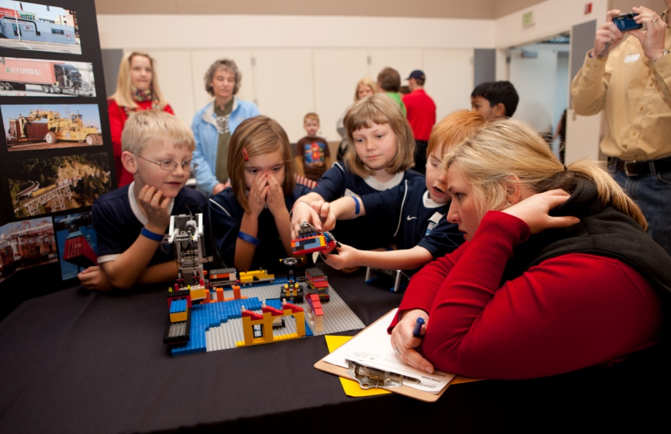
Jr.FLL Events
Official events are called Expos
Up to 4 hours long
Up to 40 teams
“Reviewers” not “Judges!”
EVERYONE Wins!
Noncompetitive
Events are held at various times throughout the season
Other Activities
World Festival Expo

Slide 14
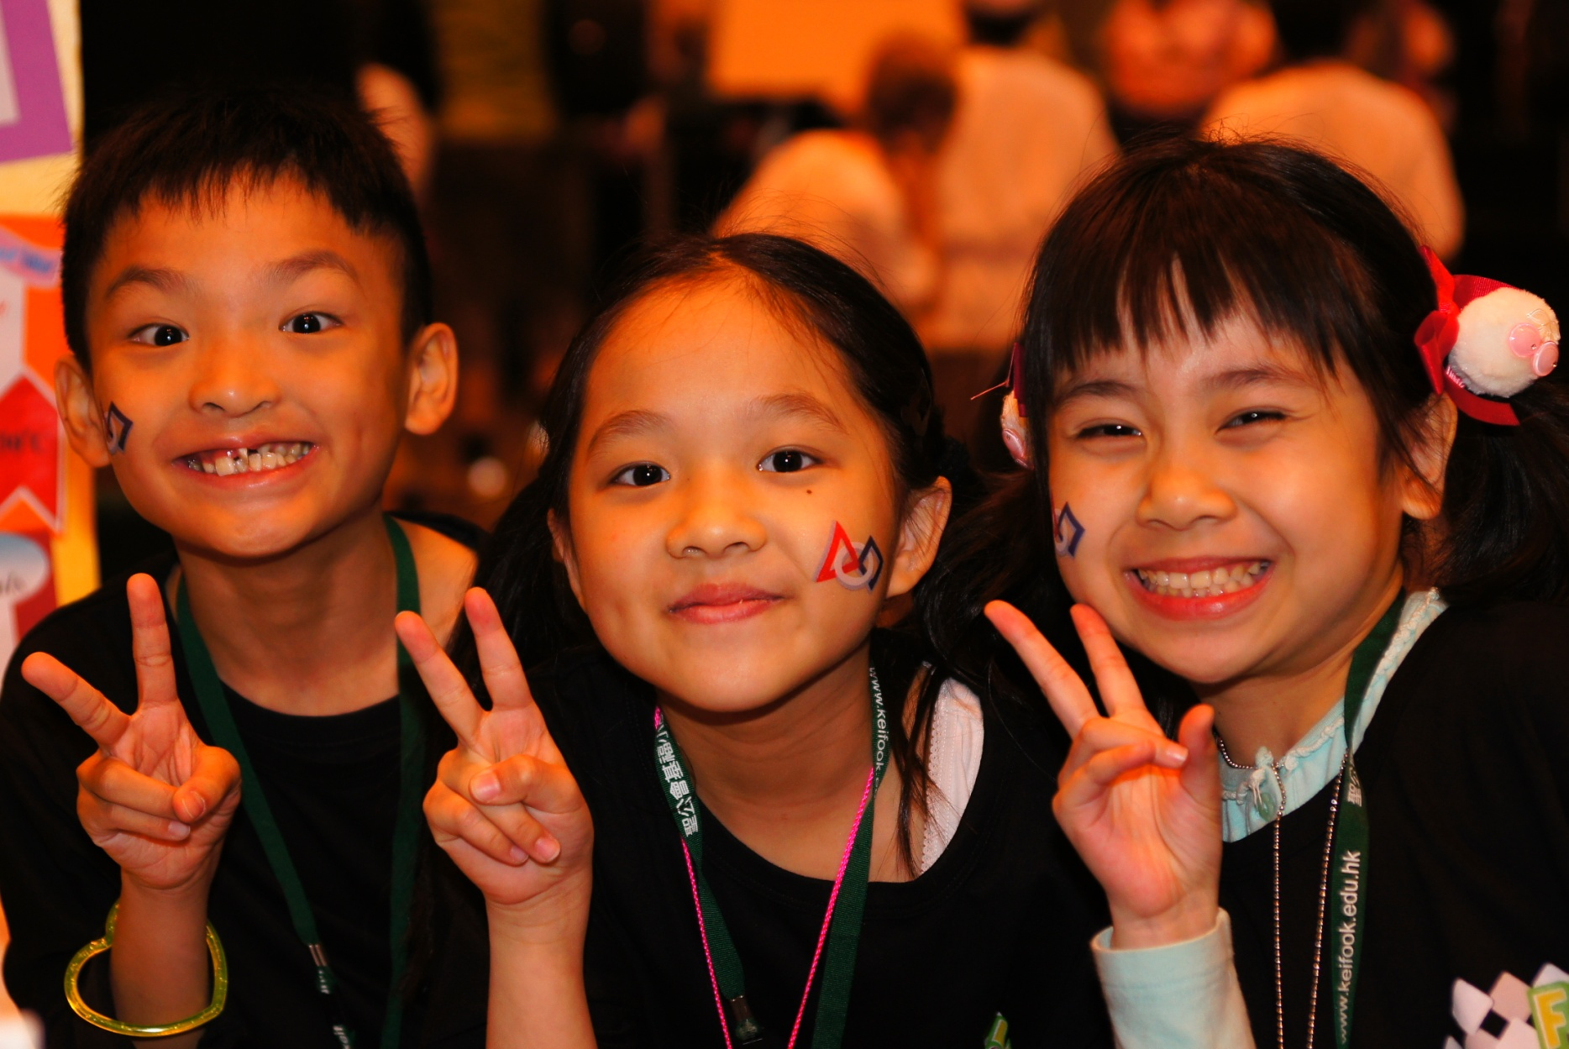
THANK YOU for supporting FIRST LEGO League Jr.!!!!

Slide 15
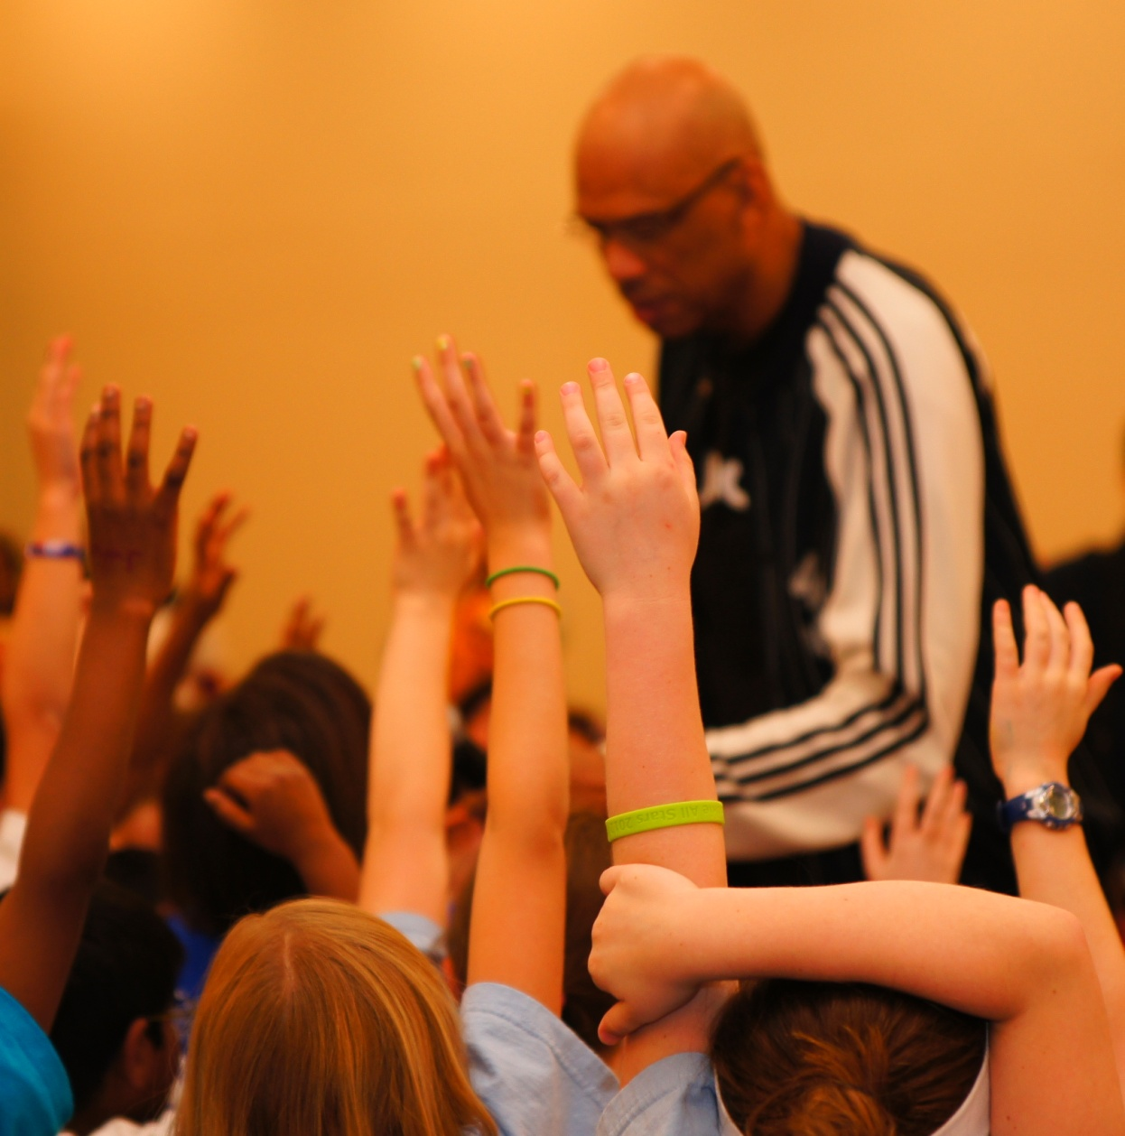
Questions??

